Slide 1

Presentation
HOME CREDIT DEFAULT RISK MODELING SERVICE
QINGYUAN WANG, SIYUAN WANG, FLORENCE WANG, ZIFAN QIAN, RICHARD PAN

Slide 2


Presentation
Context
03
Hypothesis
06
Data
08
Model
10
Results
13
Threats to Validity
15
Conclusion
16
02
/
10

Slide 3

Presentation
Context
Problem Setting
Applicants with limited or non-traditional credit history
Need probabilistic risk ranking (not rule-based decisions)
Objective
Rank applicants by default risk to support smarter approve / review / decline decisions
Optimize ranking quality under operational constraints
04
/
10

Slide 4
Presentation
Context
Business Value
Better risk ranking reduces credit losses
Probability scores enable risk-based policies
Explainable outputs support analyst review and governance
Key Assumptions
100K applications/year, 60% approval rate
Baseline default rate: 6%, LGD: 45%
Projected Annual Savings
Conservative: $0.52M
Moderate: $0.84M
Upside: $1.17M
05
/
10

Slide 5

Presentation
Hypothesis
Predictable Outcome
Applicant-level features combined with aggregated historical credit behavior contain sufficient signal to rank future default risk meaningfully above random.
Statistical Hypothesis
H₀ (Null): Model ranking = chance (ROC-AUC ≤ 0.50)
H₁ (Alternative): Model ranking > chance (ROC-AUC > 0.50)
Error Types & Business Impact
Error Type | Definition | Business Impact
Type I (False Positive) | Classify reliable borrower as high risk | Lost revenue, reduced acquisition, fairness concerns
Type II (False Negative) | Classify high-risk borrower as low risk | Elevated defaults, write-offs
06
/
10

Slide 6
Presentation
Hypothesis
Governance: Threshold policy balances both errors based on loss ratio and business tolerance.
Hypothesis Testing Strategy
Stratified train/validation split (preserves 8.07% positive class ratio)
ROC-AUC as threshold-independent metric (robust to class imbalance)
Early stopping on validation AUC to prevent overfitting
Confidence interval: Single holdout currently; recommend 5-fold stratified CV for robustness
Threshold Decision Logic
Default threshold: 0.50
Decision rule:
p(default) ≥ threshold → Escalate/decline
p(default) < threshold → Approve/standard terms
Optimization: Use expected value curves (loss ratio-based), not accuracy
07
/
10

Slide 7
Data
Presentation
Content | Source | Rows | Columns
Main table with target | application_train.csv | 307,511 | 122
Credit bureau history | bureau.csv | 1,716,428 | 17
Monthly bureau status | bureau_balance.csv | 27M | 3
Prior applications | previous_application.csv | 1.67M | 37
POS/cash loan monthly | POS_CASH_balance.csv | 10M | 8
Payment history | installments_payments.csv | 13.6M | 8
Card monthly balances | credit_card_balance.csv | 3.84M | 23
Aggregation Strategy
Primary key: SK_ID_CURR (applicant ID)
Base features: Income, credit amount, employment days + computed ratios:
CREDIT_INCOME_RATIO, ANNUITY_INCOME_RATIO, CREDIT_ANNUITY_RATIO, DAYS_EMPLOYED_PCT
Auxiliary aggregates (per applicant): mean, max, min, sum, std, count across all sources
08
/
10

Slide 8
Presentation
Data
Before Aggregation:
Source tables span 58M rows, highly skewed (many-to-one joins)
41 columns with >50% missingness in application_train
Highestmissing: COMMONAREA_*, NONLIVINGAPARTMENTS_*, LIVINGAPARTMENTS_* (~69%)
After Aggregation:
Consolidated to 307,511 applicant rows
Feature set enriched with historical summary statistics
Handled via imputation (NaN tokens for categoricals, numeric coercion)
Class Imbalance Profile
Positive class (TARGET=1): 24,825 (8.07%)
Negative class (TARGET=0): 282,686 (91.93%)
Strategy: LightGBM scale_pos_weight = negatives/positives during training
09
/
10

Slide 9


Presentation
Model
Model Type & Approach
Problem: Binary classification (supervised learning)
Algorithm: LightGBM (gradient boosting)
Framework: Scikit-learn compatible pipeline (preprocessing → estimator)
10
/
10

Slide 10

Presentation
Model
Dataset Split & Validation Strategy
Strategy: Stratified train/validation split (preserves positive class ratio)
Example on full dataset:
Train: ~246,000 rows (80%)
Validation: ~61,500 rows (20%)
Evaluation Metrics
Primary: ROC-AUC (threshold-independent, robust to imbalance)
Secondary (reported): Accuracy, Precision, Recall
Baseline: Random ranking (0.50 AUC)
12
/
10

Slide 11
Presentation
Methodology
Preprocessing:
Cleaning (e.g., DAYS_EMPLOYED=365243 → NaN)
Ordinal encoding for categorical features with __MISSING__ token
Numeric coercion with error handling
Training Configuration:
Objective: ROC-AUC optimization
Class weighting: scale_pos_weight to address ~8% positive class
Early stopping: monitored on validation AUC
Regularization: subsampling + feature subsampling
Hyperparameters (stored in training_report.json):
Tree-based boosting with standard regularization (L1/L2)
Random seed: fixed for reproducibility
11
/
10

Slide 12


Presentation
Results
Summary
Validation ROC-AUC: 0.7881 → Good risk ranking separation
03
/
10

Slide 13

Borcelle
Presentation
Results
Operational Implications
Model successfully differentiates likely defaulters from non-defaulters
Ranking enables segmented policy:
Low-risk band (p < 0.30): Auto-approve with standard terms
Medium-risk band (0.30 ≤ p ≤ 0.70): Manual review
High-risk band (p > 0.70): Decline or require collateral/co-signer
Threshold Sensitivity
ROC-AUC metric is threshold-independent (evaluated across all decision points)
Threshold choice (0.50 default) is a policy lever, not training objective
Lower thresholds → more risk capture (fewer false negatives) but more false positives
Higher thresholds → preserve approvals but risk higher default losses
13
/
10

Slide 14
Presentation
Explaination
Local Drivers — Per-Prediction Explanation
Purpose: Explain why this specific applicant received this risk score.
Implementation
service.py
LightGBM with pred_contrib=True
Returns:
top_contributors
base_value
Final prediction
How it works
Decomposes prediction into additive feature contributions
Each feature pushes risk ↑ or ↓
Sum of contributions + base value = final score
Business Value
Supports underwriting transparency
Enables case-by-case review
Improves regulatory interpretability
14
/
10

Slide 15
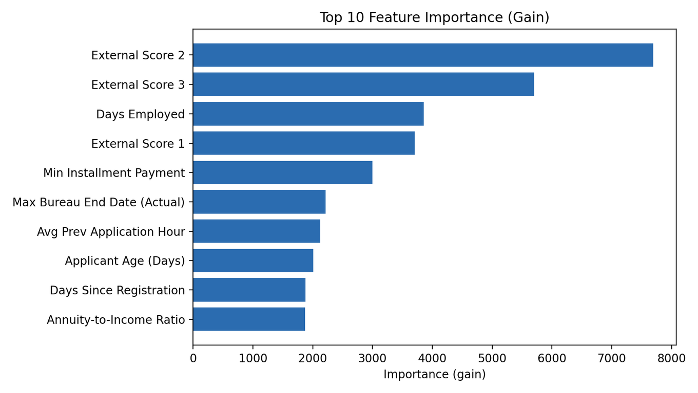
Explaination
Presentation
Global Drivers — Model-Level Explanation
Purpose: Explain what generally drives default risk across all applicants.
Implementation
Feature importance stored during training (modeling.py)
Exposed via API endpoint (main.py)
GET /feature-importance
Metrics Used
Gain importance
Split importance
Output
Ranked list of most influential features
Business Value
Portfolio-level insight
Model validation & monitoring
Strategy alignment
14
/
10

Slide 16
Presentation
Threats to Validity
aaaaa
15
/
10

Slide 17
Presentation
Conclusions
Model Value
ROC-AUC = 0.788 → strong risk-ranking signal
Clearly outperforms random baseline (0.50)
Governance & Next Steps
Quarterly retraining + drift monitoring
Track false positives / negatives
Validate impact via A/B testing
Business Recommendation
Use model for 3-band risk policy (Low / Medium / High)
Manual review for medium-risk cases
Estimated value: $0.52M–$1.17M / year
Decision Implication
Adopt: better risk control + revenue upside
Reject: higher defaults, missed optimization
16
/
10

Slide 18
Presentation
THANK
YOU
SWIPE SMART: MASTERING CREDIT WITHOUT THE STRESS

